Slide 1
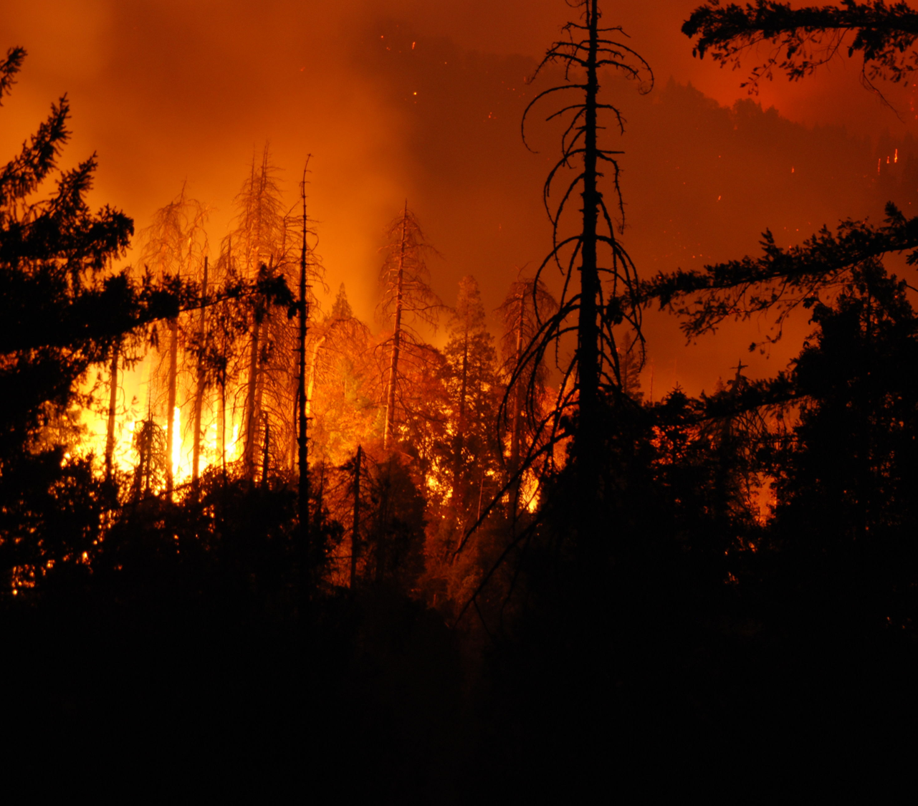
ANALZING FOREST FIRE DATA
S.NIVETHA
RA2432241040034

Slide 2

ABSTRACT
Forest fires can cause damage to the environment, wildlife, and human lives. Early detection is crucial to prevent large-scale wildwood.
This study uses R programming to detect forest fires by analyzing satellite images and environmental data. R’s powerful tools are used to process data like temperature, humidity, and vegetation levels.
By using Random Forest algorithms , the model can identify patterns that indicate a fire might be happening or is about to occur.
The system that helps to predict potential fire outbreaks, allowing authorities to act quickly. The approach is efficient and accessible, making it a valuable tool for managing forest fires and protecting the environment.

Slide 3
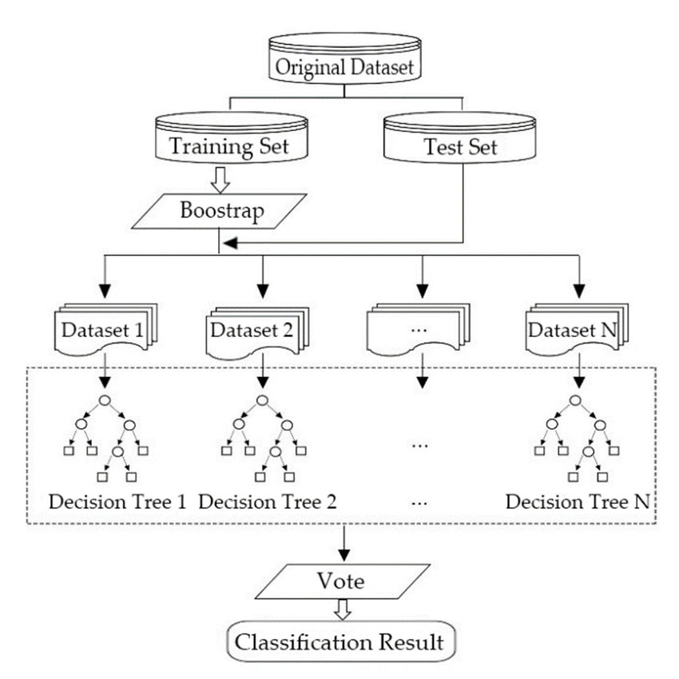
METHODOLOGY
Forest fire detection system using R programming, satellite imagery data to identify potential fire hotspots by applying image processing techniques and RANDOM FOREST algorithms to extract key features like temperature anomalies and pixel color variations, enabling early detection and alert for timely intervention.
The methodology involves in forest fire system are data pre-processing, feature extraction, model training with classification algorithms like random forest, and evaluation of accuracy to optimize the system's performance in identifying fire occurrences within a given forest area
1
Input Data: Represent the collection of raw datasets.
2
Data Preprocessing: Include cleaning, handling missing values, and splitting into training/testing sets.
3
Feature Extraction: Highlight critical data points from
environmental variables.
4
Model Development: Show the use of Random Forest to predict fire risks.
5
Evaluation: Indicate assessment of model metrics like RMSE.
6
Visualization and Interface: Display the results using an interactive app.

Slide 4
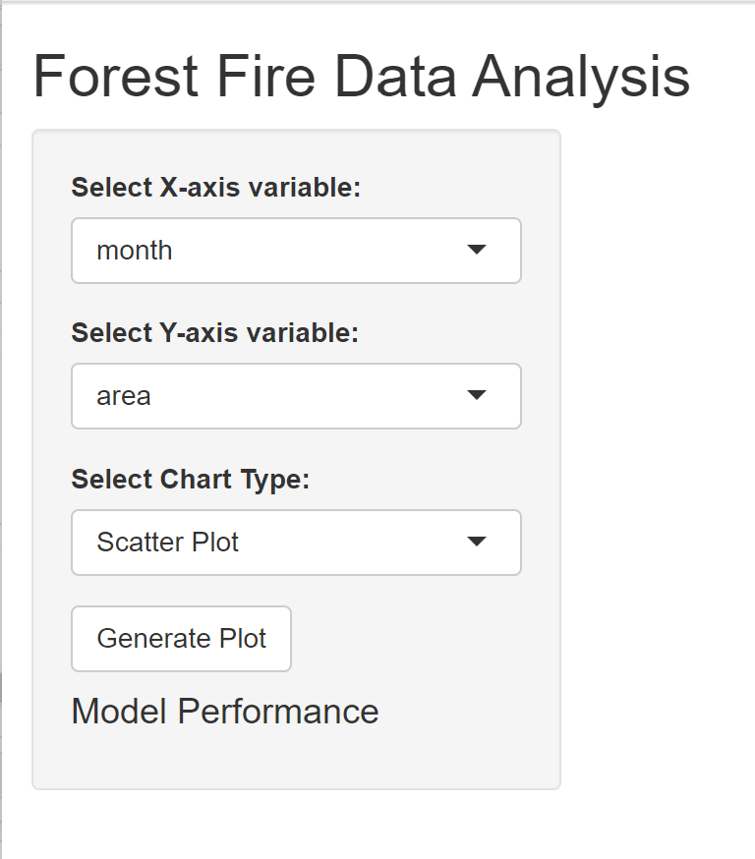
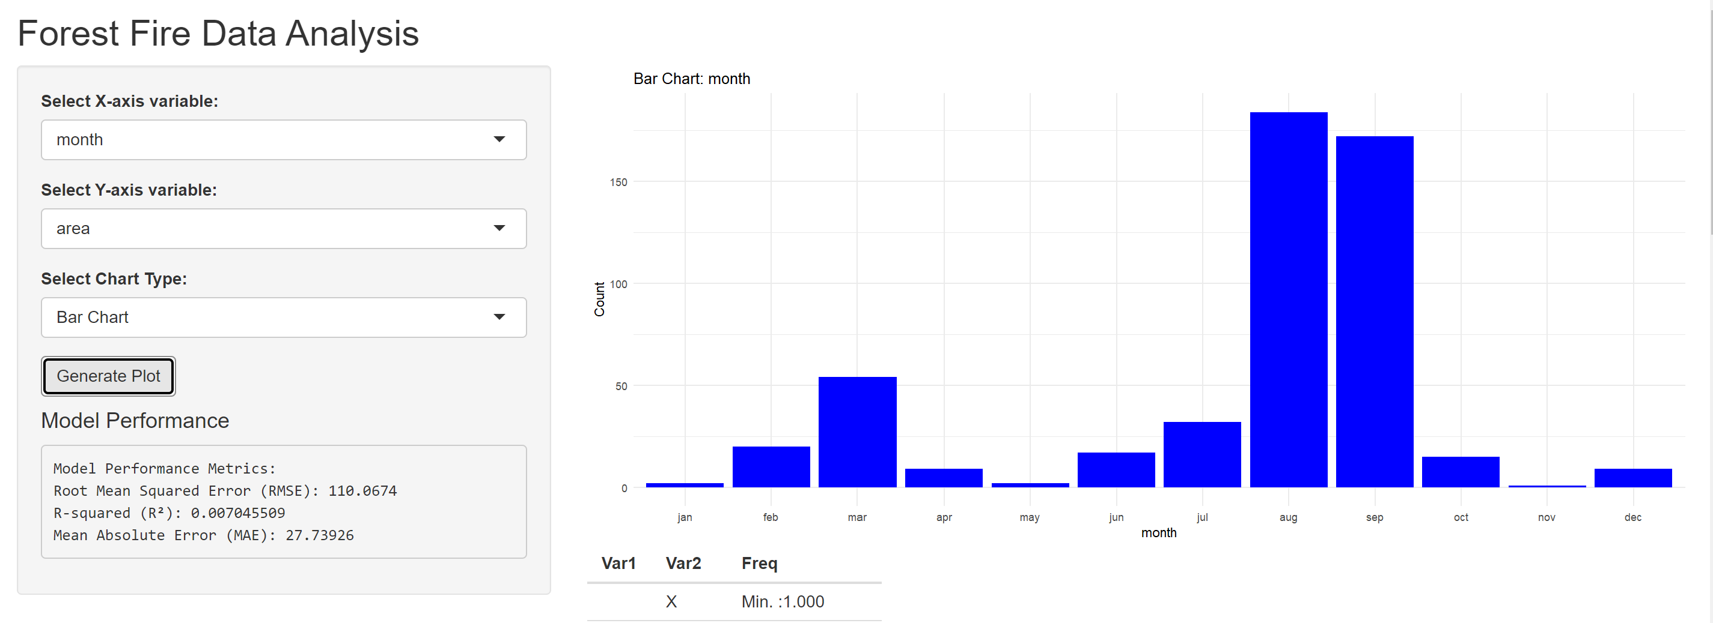
INPUT/OUTPUT SCREEN
INPUT SCREEN
OUTPUT SCREEN

Slide 5
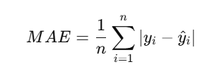
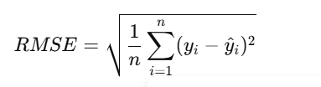
RESULT
EVALUATION METRICS:
For evaluating your Random Forest for Analysing forest fire data prediction, you can use the following evaluation metrics:
1. Mean Absolute Error (MAE):
Formula:
Measures the average absolute difference between actual and predicted values.
Lower MAE means better accuracy.
2. Root Mean Squared Error (RMSE)
Formula:
Penalizes larger errors more than MAE.
Lower RMSE is better.
Output:

Slide 6

Conclusion
Key Findings: Highlight the major outcomes from the forest fire data analysis whether it is the factors affecting fire severity, trends observed, or the significance of machine learning in predictive modeling.
Impact: Underline how these insights can be applied in real-world scenarios, such as improving forest management or implementing early warning systems for fires.
Future Scope: Mention any recommendations for further research or enhancements to your system, like exploring other datasets, refining the model, or using advanced visualizations.
Final Thought: Wrap up with a compelling statement that underscores the relevance of your work to environmental conservation and decision-making.

Slide 7

References
Kaggle. (n.d.). Forest fire data UCI Dataset.
Data Camp. (n.d.). RANDOM FOREST in
R.Retrieved from https://www.datacamp.com/community/tutorials/logistic-regression-R
R-bloggers. (2020). Data Visualization with ggplot2 in R. Retrieved from https://www.r-bloggers.com/2020/10/data-visualization-with-ggplot2-in-r/

Slide 8
THANK YOU..!!
THANK YOU FOR GIVING ME THE OPPORTUNITY

